Slide 1
Oral Communication
Confidence • Clarity • Fluency

Slide 2
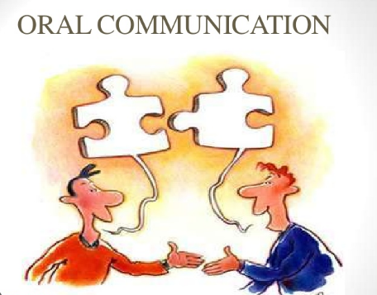

Slide 3
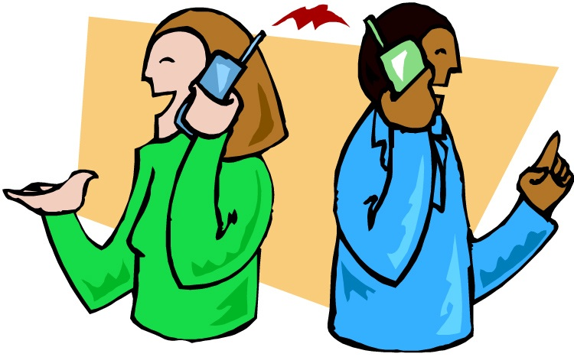
ORAL COMMUNICATION
Meaning:-
Oral communication is the interchange of verbal messages between sender and receiver . In oral communication , the sender & receiver exchange their thoughts or ideas verbally either face to face discussion or through any mechanical or electrical device like telephone ,etc. In business oral communication is used more than written communication . It is more natural and informal.

Slide 4
Definition
Oral communication is the process of exchanging ideas, information, or feelings through spoken words. It involves both speaking and listening.
According to university of Virginia , Oral communication Competency report ,”Oral communication is defined as the effective interpretation , composition, and presentation of information , ideas and values to a specific audience.”

Slide 5
Oral communication is the exchange of information and ideas through spoken word. It can be directly in person in a face-to-face interaction or through an electronic device such as a phone, video platform or radio. The most effective way for businesses to transmit information verbally is through oral communication, such as a staff meeting, webinar and workshop.

Slide 6
The 5 elements of oral communication
Sender: The sender is the person who initiates communication to the receiver.
Medium: The medium is the format in which the message is being sent. For example, a voicemail, a face-to-face conversation or a PPT.
Channel: The channel is the platform on which the message is delivered. For example, a podcast, a telephone or a meeting.
Receiver: The receiver listens and decodes the message sent by the sender. The receiver then generates feedback for the sender in response to the message.
Feedback: This final stage is the reaction of the receiver, such as oral or written communication. No response from the receiver is also a type of feedback. This completes the entire oral communication cycle.

Slide 7
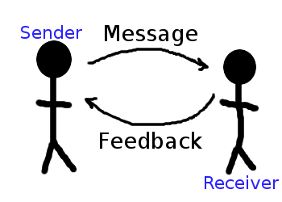

Slide 8
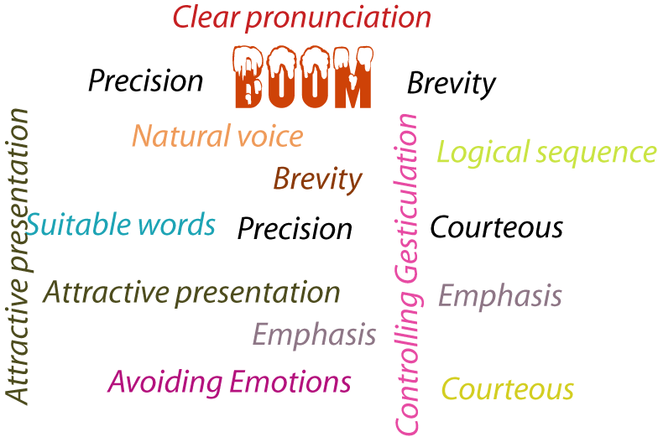
PRINCIPLES OF SUCCESSFUL ORAL COMMUNICATION
Well Planned
Clear Pronunciation
Brevity
Precision
Natural voice
Logical sequence
Suitable words
Attractive presentation
Avoiding emotions
Emphasis

Slide 9
Well Planned:- Before presenting something, there should be proper planning regarding the audience, topics to be delivered , timing & other factors . So person must be well-prepared to deliver his/her speech.
Clear pronunciation:- Words should be clearly & correctly pronounced . There should not be any lack of clarity , otherwise the communication would be confusing one.
Brevity:- The messages should be brief . If the sender take’s a long time for talking ,his message may not get the attention of the receiver.
Precision:- It is needed to make oral communication effective. There should not be any confusing words rather message to be delivered should be specific so that there is no misunderstanding.
Natural voice:- Any sort of unnatural voice may distort the message. Natural voice can do a lot to make oral communication effective.

Slide 10
Logical sequence:- Ideas should be organized in a sequential way to make the message communicative & attractive .
Suitable words:- Words have different meanings to different people in different situations in oral communication, a speaker should use the common , simple & familiar words so that receiver can react to the message without any problem.
Attractive presentation:- It is another principle to make oral communication effective . A speaker should deliver his / her speech in a very nice & sweet language so that receiver is attracted to take part in the communication.
Avoiding emotions:- Speaker must control his emotions to make oral communication effective . Too much emotion will take the speaker away from the main subject.
Emphasis :- The speaker must be knowledgeable regarding the portion of the speech where he/she should give emphasis. Giving emphasis on respective points will help draw the attention of the audience.

Slide 11
How it works
Verbal Expression: Using words, their pronunciation, and combinations to convey a message.
Non-Verbal Cues: Incorporating tone of voice, facial expressions, and body language to add meaning and context.
Active Listening: Paying close attention to the speaker to understand the message fully and provide feedback.

Slide 12
Types of Oral Communication
1. Interpersonal – one-to-one conversation
2. Group Communication – discussions, meetings
3. Public Speaking – speeches, presentations
4. Mass Communication – TV, radio, announcements

Slide 13
Types of Oral Communication
Face-to-Face: In-person conversations, meetings, interviews, and presentations.
Electronic/Remote: Phone calls, video conferencing, and podcasts.
Formal: Structured events like business meetings, lectures, and webinars.
Informal: Casual exchanges such as personal conversations with friends and family.

Slide 14
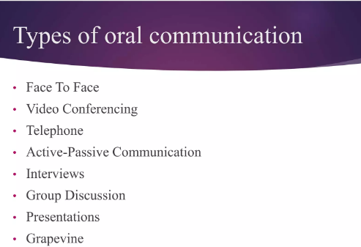

Slide 15
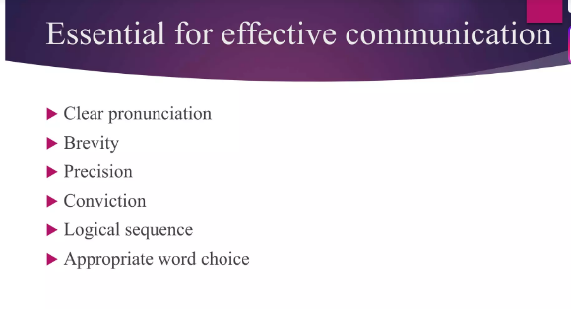

Slide 16
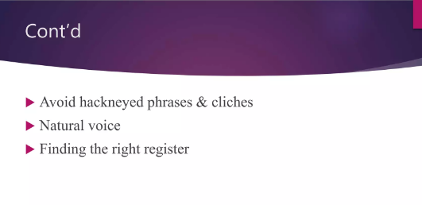

Slide 17
Features of Oral Communication
• Uses spoken language
• Immediate feedback is possible
• More personal and interactive
• Relies on tone, pitch, and body language

Slide 18
Key Aspects of Oral Communication
Use of Spoken Words: The primary method of transmission is through verbal sounds and words.
Two-Way Process: It involves both speaking (sending the message) and listening (receiving and understanding the message).
Forms: Can be formal (e.g., presentations, lectures, speeches) or informal (e.g., casual conversations with colleagues or friends).

Slide 19
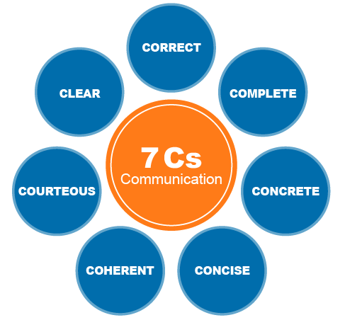

Slide 20
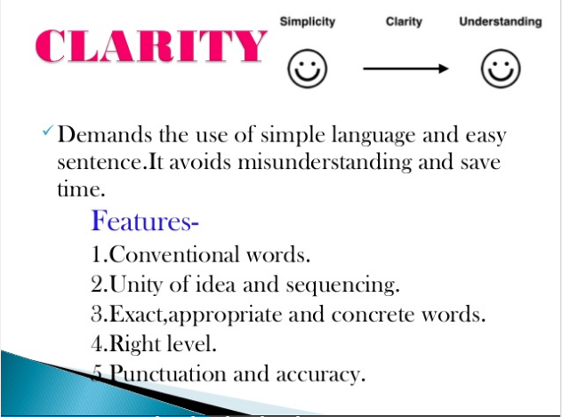

Slide 21
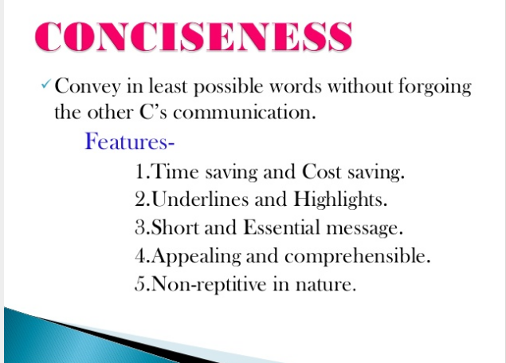

Slide 22
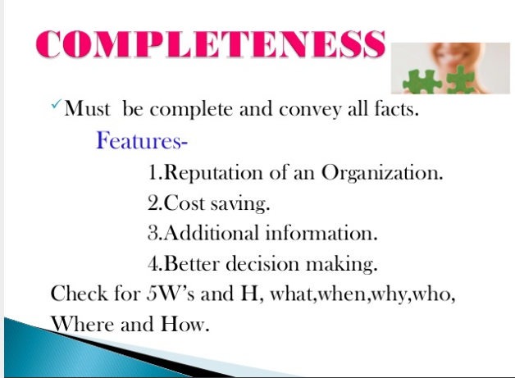

Slide 23
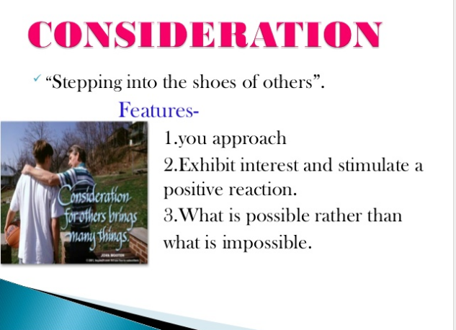

Slide 24
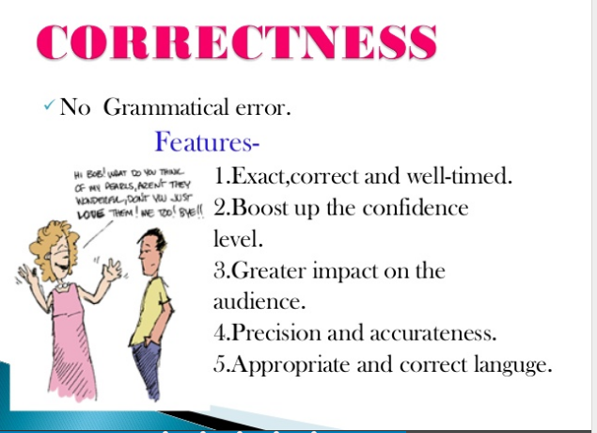

Slide 25
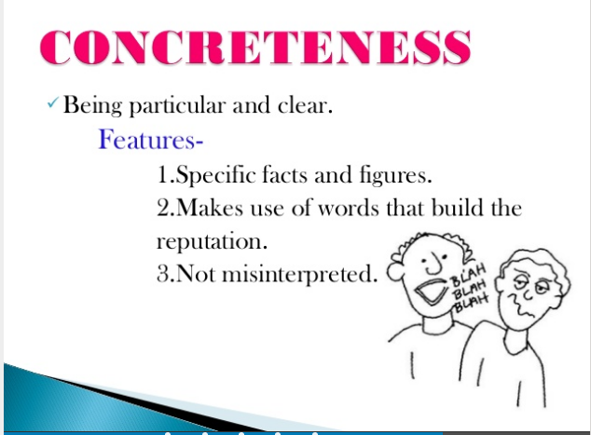

Slide 26
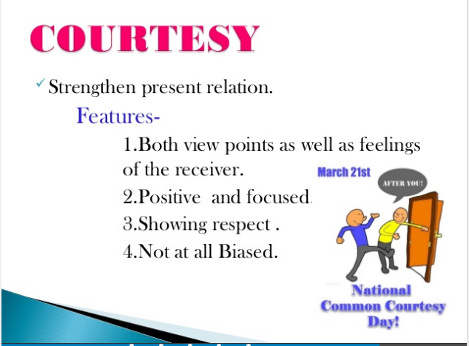

Slide 27
Importance of Oral Communication
• Builds relationships and teamwork
• Enhances learning and understanding
• Develops leadership and influence
• Essential for professional success

Slide 28
Qualities of Good Oral Communication
• Confidence – speak boldly
• Clarity – use simple, clear language
• Fluency – smooth flow of speech
• Active Listening – respond appropriately

Slide 29
Confidence
Confidence in communication is the self-assurance to express thoughts clearly, build rapport, and persuade others effectively. To build it, prepare and practice, use positive and assertive language, maintain confident body language (good posture, steady eye contact, relaxed gestures), and focus on your audience's needs rather than self-judgment. Listening actively, being mindful of others, avoiding filler words, and learning from mistakes are also key to becoming a confident communicator.

Slide 30
Why Confidence Matters
Clear & Impactful Message:
When you believe in what you are saying, your message comes across with clarity and conviction.
Builds Trust:
A confident communicator establishes credibility and authority, making listeners more likely to trust and engage with them.
Captures Attention:
Confidence helps you capture and maintain your audience's attention, preventing your message from being lost.

Slide 31
Developing Confident Communication Skills
Preparation and Practice:
Know your purpose and goals, and then prepare your message thoroughly. Practice in front of a mirror, with a supportive friend, or by observing and learning from confident communicators.
Confident Body Language:
Use open and relaxed postures, maintain good eye contact, and use appropriate gestures. A friendly smile can also convey confidence.
Positive and Assertive Language:
Use clear, assertive language and avoid words like "but," opting for "and" instead. Be positive and focus on solutions rather than problems.
Focus on Your Audience:
Understand what your audience needs from the interaction, rather than focusing solely on yourself. This shift in focus can reduce anxiety and increase effectiveness.
Mindfulness and Active Listening:
Stay calm during interactions and be mindful of the other person. Listen actively to understand their perspective before responding.
Learn and Grow:
Be open to feedback and willing to learn from mistakes. This helps you improve and grow as a communicator.

Slide 32
Clarity
In oral communication clarity is the ability to express ideas precisely and understandably, avoiding confusion and ambiguity for your audience. To achieve this, use simple language, avoid jargon, limit complex sentences, focus on one idea at a time, and consider your audience's knowledge level. Improving clarity also involves active listening, seeking feedback, and ensuring your physical delivery is clear, as mumbling or fast speech can hinder comprehension.

Slide 33
Key Principles of Clear Communication
Simple Language: Use plain, direct language instead of complex, technical terms or jargon.
Conciseness: Focus on key points and avoid unnecessary details that can confuse the message.
Single Idea per Sentence: Address one concept at a time to make it easier for the listener to follow.
Audience Awareness: Tailor your message to the audience's understanding, avoiding overly complex or unfamiliar terminology.
Active Voice: Employ an active voice to create direct and clear sentences.

Slide 34
Why Clarity Matters
Prevents Misunderstanding:
Clear communication ensures the message is received as intended, reducing misinterpretations.
Boosts Confidence:
A clear message makes the audience feel confident in the information shared.
Enhances Credibility:
Clear speech projects knowledge and builds trust in your abilities.
Drives Action:
When a message is clear, the audience is more likely to understand and act on it.

Slide 35
Tips to Improve Clarity
Define your Purpose: Know exactly what you want to convey before you start speaking.
Use Clear Enunciation: Speak clearly and at a moderate pace so your words are understood.
Avoid Unnecessary Terms: Limit or omit slang, idioms, and excessive technical jargon.
Seek Feedback: Ask your audience for clarification to ensure your message was understood correctly.
Structure Your Message: Organize your thoughts logically so the information flows smoothly.
Be Consistent: Consistent clarity builds trust and credibility with your listeners.

Slide 36
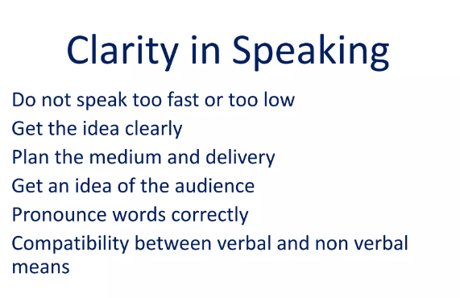

Slide 37
Fluency
Oral communication fluency is the ability to express thoughts clearly, confidently, and naturally in spoken language, characterized by a smooth, effortless speech rate, appropriate pauses, and correct rhythm, intonation, and stress. It involves more than just speaking fast; it emphasizes ease and accuracy, allowing the speaker to understand and be understood by others without significant hesitation or cognitive effort. Developing oral fluency involves activities like listening and repeating, practicing with familiar topics, and focusing on speech rate, pauses, and formulaic expressions to improve conversational flow.

Slide 38
Fluency refers to the ability to speak, write, or comprehend a language with ease and accuracy. It is essential to effective communication, mainly when clear and concise communication is critical. Fluency is not just about speaking or writing swiftly; it is about expressing oneself clearly, confidently, and accurately.

Slide 39
Key Aspects of Oral Fluency
Speech Rate: A natural and consistent pace of speech.
Pausing: Using pauses effectively and pausing less frequently between words and ideas.
Length of Speech Runs: The ability to speak in longer, uninterrupted phrases or sentences.
Rhythm and Intonation: The natural stress, pitch, and stress patterns of a language.
Linking: Connecting sounds and words together smoothly to create a continuous flow.
Effortless Delivery: Expressing oneself with ease and spontaneity, without noticeable cognitive effort.
Clarity: The ability to be easily understood by others.

Slide 40
How to Develop Oral Fluency
Listen and Repeat:
Imitate native speakers by listening to audiobooks and recordings, which helps with pronunciation, intonation, and natural flow.
Practice with Familiar Topics:
Engage in conversations about familiar and motivating subjects to build confidence and improve expression.
Focus on Speech Mechanics:
Pay attention to rhythm, intonation, and stress patterns to make speech sound more natural.
Use Formulaic Sequences:
Incorporate common phrases and sentence connectors to improve conversational flow and speed.
Practice Daily:
Consistent, daily practice is essential for improving language proficiency and making speaking effortless.
Increase Speaking Time:
Actively seek opportunities to speak, gradually increasing the duration of speech to build stamina and confidence.

Slide 41
Active listening
Active listening is the conscious practice of focusing entirely on the speaker to fully understand their message, rather than just hearing words to formulate a response. It involves paying full attention, avoiding interruptions, asking clarifying questions, paraphrasing to confirm understanding, and showing interest through non-verbal cues like eye contact and nodding. This technique builds trust, fosters deeper relationships, and promotes more effective communication by making the speaker feel heard and understood

Slide 42
Why Active Listening is Important
Improved Communication:
It reduces misunderstandings by ensuring both parties are on the same page.
Stronger Relationships:
It makes the speaker feel valued and understood, which builds trust and strengthens connections.
Enhanced Problem-Solving:
By truly understanding another person's perspective, you can respond more productively and find better solutions.
Better Information Retention:
Engaging actively with the speaker helps you better comprehend and remember the information.

Slide 43
Key Aspects of Active Listening
Full Attention:
Give the speaker your undivided attention, focusing on their message and intent rather than getting distracted by your own thoughts.
Non-Interruption:
Allow the speaker to finish their thoughts without cutting them off, which is a key part of active listening.
Interest & Empathy:
Show you are engaged by maintaining eye contact, nodding, and using open-ended questions to encourage further sharing.
Paraphrasing:
Rephrase what the speaker has said in your own words to confirm your understanding and show you're on the same page.
Open-ended Questions:
Ask questions like "How did you feel?" or "What did you think?" to encourage the speaker to elaborate and provide more details.
Observing Non-verbal Cues:
Pay attention to the speaker's body language and emotional cues to gain a fuller picture of their message.

Slide 44
Importance and Benefits of Oral Communication
Immediate Feedback: Allows for spontaneous responses and quick decision-making.
Builds Rapport: Face-to-face interactions help in building trust and connection between people.
Efficiency: It can be a quick way to convey information and resolve problems.
Non-Verbal Cues: Provides additional information through tone of voice, facial expressions, and body language.
Teamwork: Essential for collaboration and coordinating tasks within a team.

Slide 45
Advantages of Oral Communication
Oral communication is a dynamic and interactive mode of information exchange, relying on spoken language and various forms of verbal interaction.
Key advantages of the oral communication approach:
1/ Immediate Feedback: One of the most significant merits of oral communication is the ability to receive immediate feedback while communicating. In face-to-face or real-time interactions, both the sender and the receiver can quickly determine each other’s reactions, understand the message’s clarity, and address any misunderstandings promptly.
2/ Quick and Efficient: Oral communication is often faster and more efficient than written communication, particularly in one-on-one or small group settings. It enables rapid decision-making, problem-solving, and coordination among team members.
3/ Immediate Adaptability: During a conversation, if the speaker notices confusion or lack of understanding in the audience, they can quickly adjust their message, rephrase it, or provide further explanations to ensure better understanding.
4/ Facilitates Group Discussions: In a group environment, oral communication enables dynamic discussions, brainstorming sessions, and collaborative decision-making. The back-and-forth nature of oral communication encourages active participation from all involved.
5/ Real-Time Clarification: Another benefit of oral communication is in situations where information is complex or ambiguous, oral communication allows for immediate clarification. The audience can seek immediate responses to their queries, which reduces confusion and helps in making well-informed decisions.
6/ Contextual Understanding: In oral communication, participants can determine the context of the message more effectively, considering the environment, mood, and situational factors that might influence the message’s meaning.

Slide 46
7/ Effective Persuasion: Skilled speakers can use persuasive language and vocal techniques, to influence and convince their audience more effectively than written communication alone.
8/ Personal Touch: Oral communication, specifically face-to-face communication, adds a personal touch to interactions, making them feel more authentic and emotionally connected, which is especially crucial in personal relationships and customer service scenarios.
9/ Immediate Conflict Resolution: In situations of conflict or disagreement, the advantage of spoken communication allows for direct discussion, leading to quicker resolution and reducing the chances of increased misunderstandings.
10/ Dynamic and Engaging Presentations: Oral communication is particularly well-suited for engaging presentations, as speakers can use visuals, demonstrations, and storytelling to captivate their audience.
11/ Real-Time Language Clarification: When using oral communication across language barriers, participants can seek immediate clarification or translation, reducing the risk of miscommunication due to language differences.
12/ Non-Verbal Cues: Beyond spoken words, the oral form of communication incorporates non-verbal cues like gestures, facial expressions, and body language, adding depth and context to the message. These non-verbal cues contribute significantly to the overall understanding of the message.

Slide 47
Disadvantages of Oral Communication
1/ Lack of Documentation: One of the significant limitations of oral communication compared to written communication is its lack of permanence. Information conveyed orally may be forgotten over time, leading to inaccuracies. In contrast, written communication provides a tangible record that can be referred back to for clarification reducing the chances of misinterpretation and ensuring accuracy.
2/ Limited Reach and Accessibility: Oral communication is limited by physical presence and real-time interaction. It may not be feasible to communicate with people who are geographically spread out or in different time zones. This limitation prevents effective communication in global or remote teams.
3/ Inefficient for Complex Information: Communicating complex or technical information solely through oral means can be challenging. It may be difficult to convey complex details without the support of visuals, charts, or written explanations, which can lead to incomplete understanding.

Slide 48
Disadvantages of Oral Communication
4/ Noise and Distractions: Oral communication can be affected by environmental factors such as background noise, interruptions, or distractions. These elements can hamper concentration and understanding, leading to ineffective communication.
5/ Emotional Influence: In oral communication, emotions can strongly influence the message’s delivery and reception. A speaker’s emotions may inadvertently impact the interpretation of the message, leading to biased understanding.
6/ Lack of Standardization: Oral communication can lack the standardization and consistency that written communication offers. The same message communicated orally by different individuals may vary in wording, tone, and emphasis, leading to confusion among recipients.

Slide 49
Disadvantages of Oral Communication
7/ Inability to Verify Information: Unlike written communication, which can be fact-checked and verified, oral communication may convey incorrect or inaccurate information without an easy way to verify its authenticity in real-time.
8/ Lack of Accessibility for People with Disabilities: Oral communication may not be accessible to individuals with hearing impairments or certain disabilities, excluding them from important interactions unless appropriate accommodations are made.
9/ Lack of Formality: Oral communication may lack the formality and structure associated with written communication, leading to a casual approach that can be unsuitable for conveying important business matters.

Slide 50
Disadvantages of Oral Communication
10/ Dependence on Speaking Skills: Effective oral communication requires good speaking skills. Individuals who are less confident may struggle to convey their ideas clearly, preventing effective communication.
11/ Risk of Information Leakage: One crucial disadvantage of oral communication in an organization is in situations where sensitive information is discussed verbally. There is a higher risk of unintentional information leakage to unauthorized individuals or competitors.
12/ Dependency on Active Listening: Effective oral communication requires active listening skills from all participants. If someone is not fully engaged or attentive, important information may be missed or misunderstood.

Slide 51


